Slide 1
Better LMS
GenAI hackathon World Cup 2024
Powered By GenAI

Slide 2
Agenda
Team Introduction
Problem Statement
Solution Overview
Demo of the Product & Code Walkthrough
Next Steps

Slide 3
Team
Dharmendra Pratap Singh
Manoj Kumar Manmathan
Praveen Kumar Gupta

Slide 4
Problem Statement
In many organizations, Learning Management Systems (LMS) primarily rely on static content such as PDFs and videos for training and development. This approach often leads to passive learning experiences that do not effectively engage learners or assess their understanding.
To address this limitation, there is a need for an innovative solution that leverages Generative AI to create dynamic, interactive content. By generating a variety of question-answer pairs, including multiple-choice questions (MCQs), fill-in-the-blanks, and true/false questions, we can transform the traditional learning experience into an engaging and customizable journey.

Slide 5
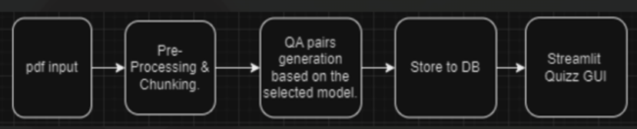
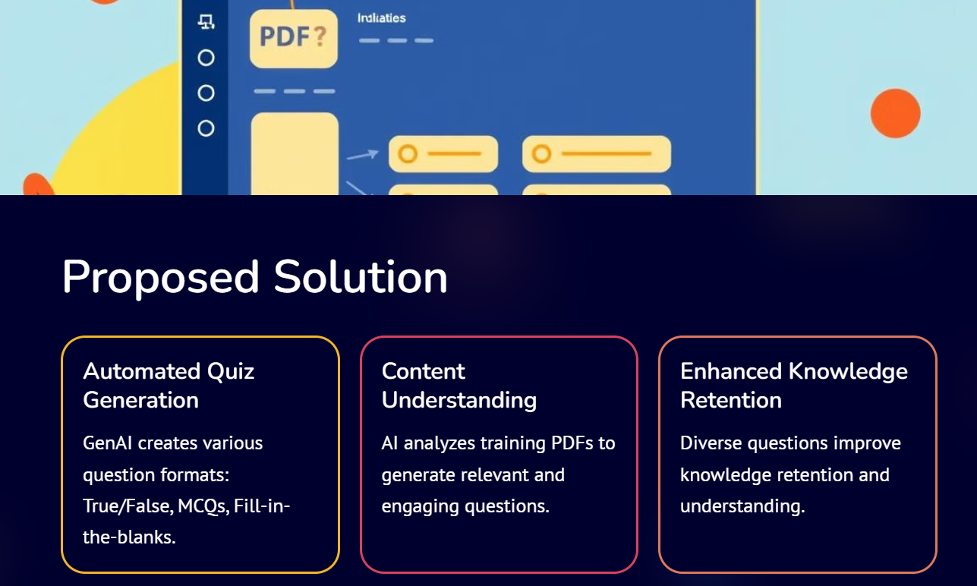
Solution Overview
Proposed Solution
Process Flow Diagram
Our Idea been to leverage GenAI and provide innovative solution to take the current corporate training to the next level by providing
Increased learner engagement and motivation through interactive assessments.
Personalized learning experiences by tailoring questions to individual progress and knowledge levels.
Enhanced retention and understanding by encouraging active participation and critical thinking.
Challenge
The challenge lies in effectively integrating this Generative AI capability into existing LMS platforms, ensuring ease of use for instructors and learners while maintaining the quality and relevance of the generated content.
By addressing these challenges, we can significantly improve the effectiveness of organizational training programs, leading to better knowledge retention and application in the workplace

Slide 6
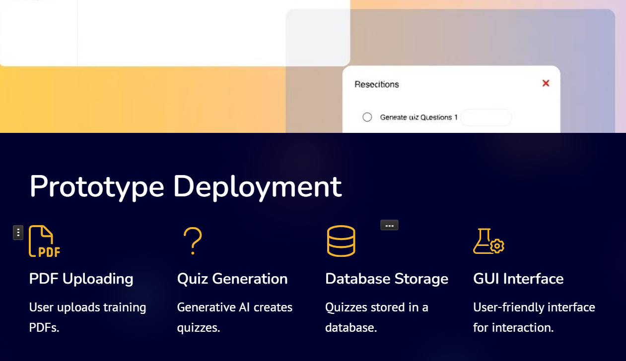
Demo
GitHub URL: https://github.com/ManojKumarM75/GenAI-WC-2024-Hackathon_Better-LMS

Slide 7
Thank You

